Slide 1
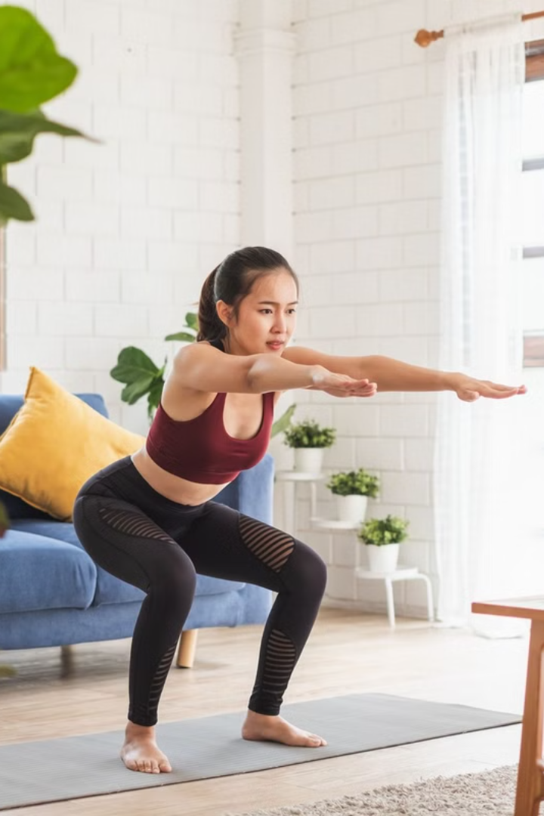
FitSync AI
Introducing our AI-powered trainer FitSync AI: the perfect solution for home workouts, designed for those who can't make it to the gym but still want a personalised fitness experience.
With advanced computer vision and machine learning, our trainer provides real-time feedback on form and performance during weightlifting and functional fitness routines—just like having a personal trainer at home. It adapts to your space and fits into your busy schedule, helping you stay on track and reach your fitness goals safely and effectively.
No gym? No problem. Get the expert guidance you need, right from the comfort of your home.

Slide 2
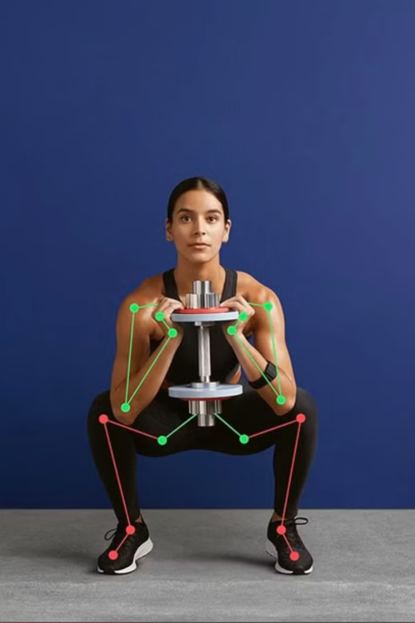



Problem Statement
Lack of Personalised Guidance
Traditional fitness apps provide generic, one-size-fits-all instructions Most home workout solutions lack real-time, personalised feedback High risk of incorrect exercise techniques leading to potential injuries
Accessibility and Affordability
Personal trainers are expensive and not accessible to everyone Advanced fitness tracking technologies are often cost-prohibitive Limited options for individuals seeking professional-level workout monitoring
Motivation and Accountability
Difficulty in maintaining consistent exercise routines Limited mechanisms to track and validate exercise performance Lack of immediate, constructive feedback during workouts

Slide 3
Revolutionising Home Workout Experience with Computer Vision
Precise Pose Detection
Injury Prevention
Leveraging advanced computer vision algorithms, our AI-powered system can accurately detect and analyse the user's body movements in real-time, providing instant feedback on proper form and technique.
Our system can identify improper poses and movement patterns that could lead to injuries, allowing users to make corrections and reduce the risk of harm during their workouts.

Slide 4
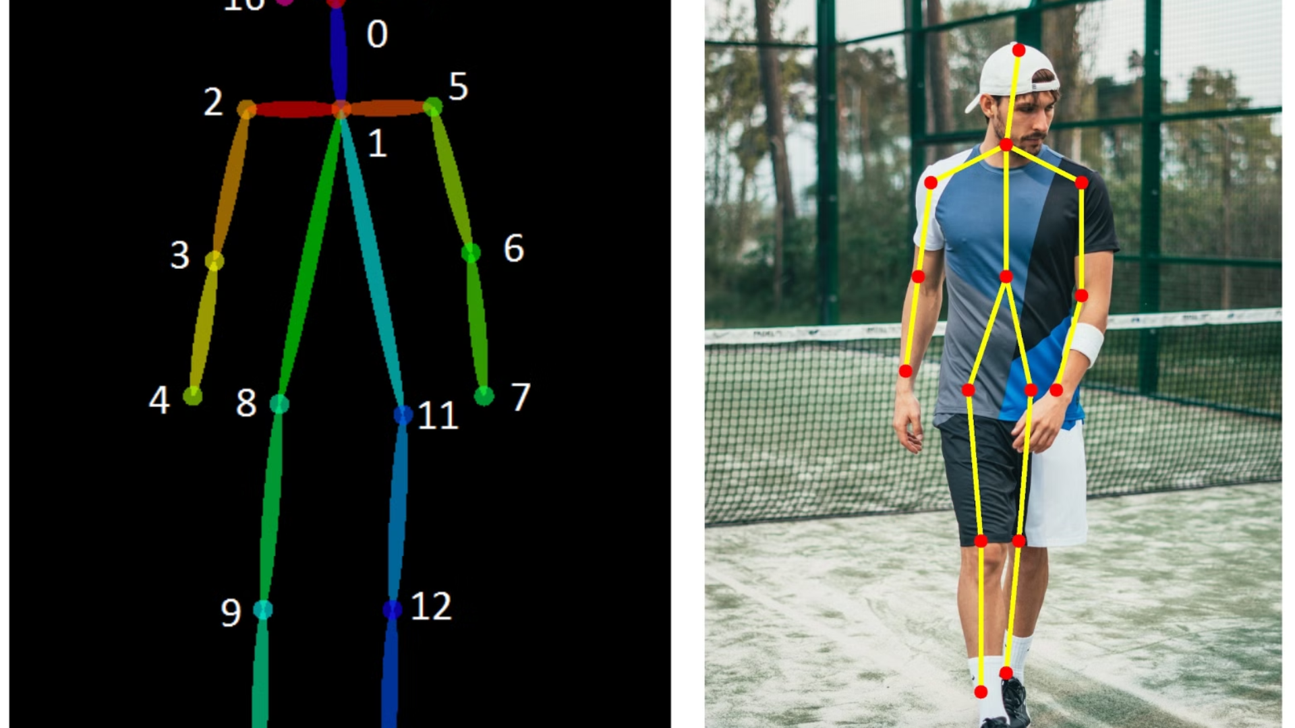
Identifying Improper Poses: The Key to Injury Prevention
1
Shoulder Alignment
2
Spinal Posture
Ensuring proper shoulder positioning is crucial for preventing injuries like rotator cuff tears and impingement.
Maintaining a neutral spine during exercises can help avoid lower back pain and other spinal issues.
3
Joint Stability
4
Range of Motion
Identifying and correcting joint instability, such as knee or ankle misalignment, can reduce the risk of sprains and strains.
Monitoring the user's range of motion during exercises can help prevent overexertion and improve overall performance.

Slide 5
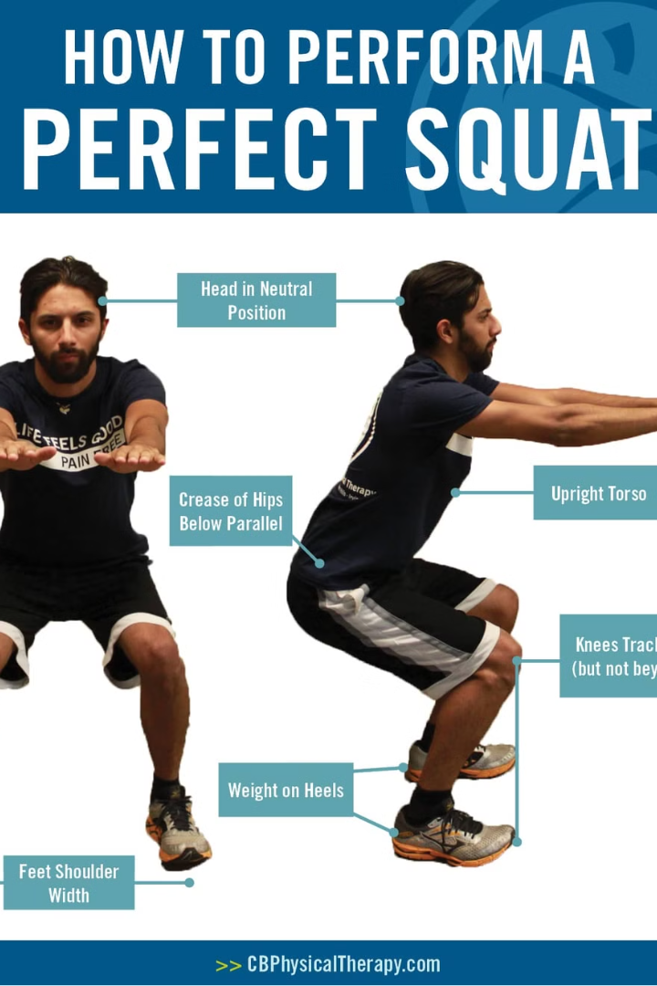



Instant Feedback for Better Form and Technique
Pose Detection
Our AI-powered system uses computer vision to continuously monitor the user's form and technique during their workout.
Real-Time Analysis
The system instantly analyses the user's movements, comparing them to optimal form and identifying any deviations or areas for improvement.
Immediate Feedback
Users receive immediate, personalised feedback through visual cues, helping them make adjustments to their form and technique in real-time.

Slide 6
FitSync AI Workflow
User Enters Workout
1
The user enters the workout space and does the workouts within the dedicated time frame
2
Pose Detection
Our computer vision AI continuously monitors the user's movements, analysing their form and technique in real-time.
Personalised Feedback
3
The AI provides instant, tailored feedback to the user, helping them correct any improper form or technique.
4
Supported Exercises
Squats
Lunges
Push-ups
Curls
Sit-ups

Slide 7

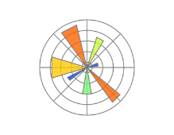





Tech Stack used to overcome problem

Slide 8
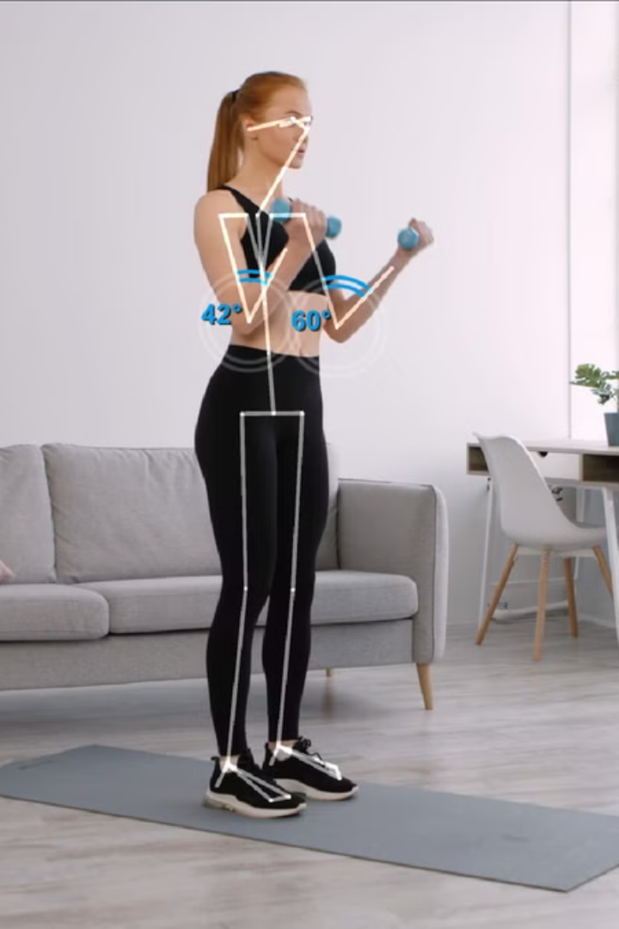
Democratising Access to Personal Trainers
1
AI-Powered Guidance
Our innovative AI system provides personalised, real-time feedback and coaching, effectively democratising access to the expertise of personal trainers.
2
Scalable Accessibility
By leveraging AI, we can scale the availability of personalised training to a wider audience, making it more affordable and accessible for everyone.
3
Continuous Improvement
The AI system learns and evolves over time, continuously improving its ability to provide accurate, personalised guidance and support to users of all fitness levels.

Slide 9
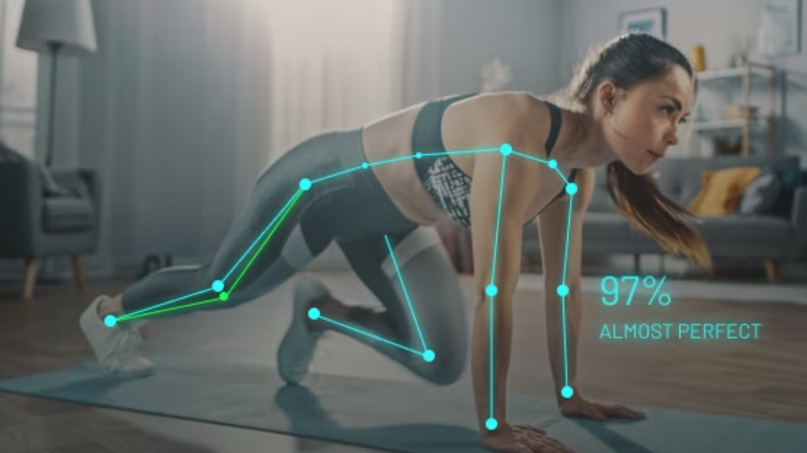
Conclusion: Transforming home workouts with AI-Powered Fitness
FitSync AI has the potential to revolutionise the home workout experience, empowering fitness enthusiasts to achieve their goals through personalised guidance, real-time feedback, and data-driven insights. By integrating cutting-edge computer vision and machine learning technologies, we can create a seamless and transformative fitness experience that democratises access to personal training and helps prevent injuries. Join us in shaping the future of fitness and unlock the full potential of AI-powered wellness.

